Slide 2
What is Risk?
COSO ERM Framework: “Risk is the possibility that events will occur and affect the achievement of objectives.”
ISO 31000 Risk Management Standard: “The effect of uncertainty on objectives.”

Slide 3
Why We Need to Manage Risk
The purpose of managing risk is to increase the likelihood of an organization achieving its objectives by being in a position to manage threats and adverse situations and being ready to take advantage of opportunities that may arise.
Guidance on Implementing ISO 31000:2009
NSAI in Ireland
Notes:
This approach links what is most important to an organization – key objectives, mission and strategy – to the management of risk, which increases the likelihood that we’ll succeed and achieve our objectives.
Optional/additional info:
NSAI = National Standards Association of Ireland. This standards body created an implementation guide to ISO 31000.
There is an international work group that is drafting an implementation guide to ISO 31000. It is due to be published in 2014. In the mean time, there are a few resources that are helpful from Ireland, Canada and Australia/New Zealand. This is an excerpt from one of them.

Slide 4
“Only 13% of [C-level] respondents believe their risk management processes support, at a high level, the ability to develop and execute business strategies.”
Deloitte: Exploring Strategic Risk

Slide 5
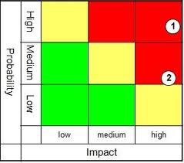
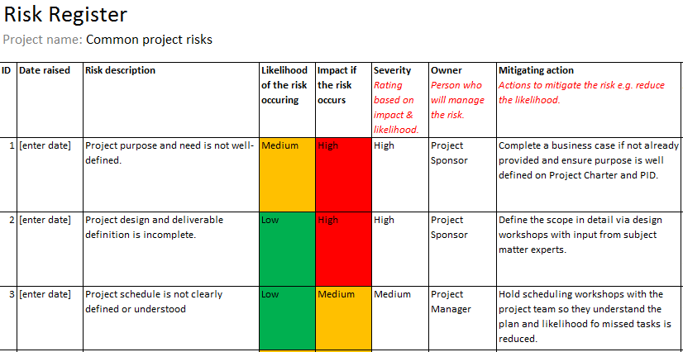

Slide 6
“An organization needs to identify [the] challenges that lie ahead and adapt to meet those challenges.
It must engage in decision-making with an awareness of both the opportunities for creating value and the risks that challenge the organization in creating value.”
COSO ERM 2017

Slide 7

It’s about Setting the Right Objectives
7

Slide 8
It’s about Executing to Achieve Objectives
8

Slide 9
It’s all about Taking the Right Risks
9

Slide 10
It’s about Making Intelligent Decisions
10

Slide 11


Slide 12
Decisions need risk information
Focus on the more significant, difficult, or complex decisions
Make it easier for decision-makers to get the information they need
Provide tailored information
Ask decision-makers what they need and for which decisions
Listen
Adapt
Agile

Slide 13
What is risk management about?
Helping leaders set the right objectives and strategies
Helping people make informed and intelligent decisions
Helping the organization take the right level of the right risks for success
Helping them achieve objectives
Helping them succeed, personally and collectively
Helping the board with their governance responsibilities

Slide 14
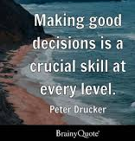
Make sure your leaders believe…
…their risk management processes support, at a high level, the ability to develop and execute business strategies.
…people are making the informed and intelligent decisions necessary for success.

Slide 15
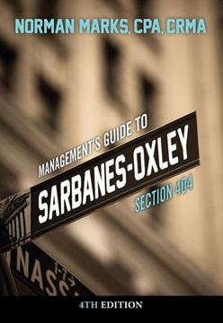


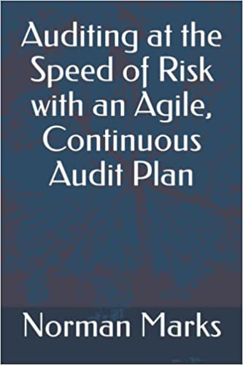

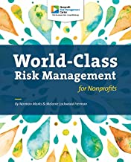



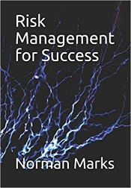


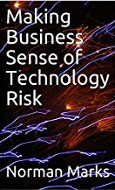

Norman Marks, CPA, CRMA
Author; Thought Leader; Member of IIA American Hall of Distinguished Practitioners; OCEG Fellow; Honorary Fellow of the Institute of Risk Management
nmarks2@yahoo.com
http://normanmarks.wordpress.com/
Twitter: @normanmarks

